Slide 1
Speeding up data processing
Fast libraries vs. pure Python
Throughput vs. latency

Slide 2
Fast libraries
Linear Algebra is the computational engine of data analysis, Neural Networks.
Can be computed in pure python
But: about 1000 times slower than using numpy
Numpy Speed similar to matlab speed.
Both use similar highly optimized libraries
Example: LAPACK, library released in 1992,
written in FORTRAN!

Slide 3
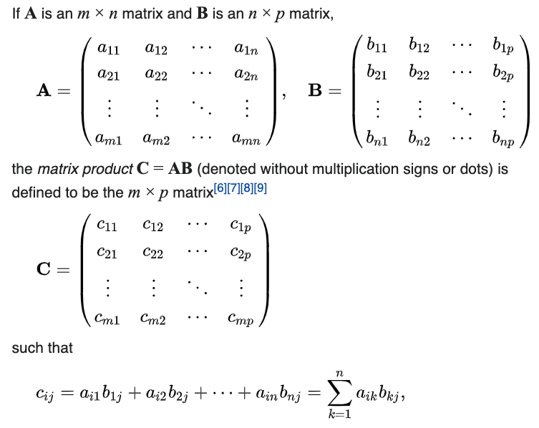
Matlab and Numpy: fast linear algebra

Slide 4
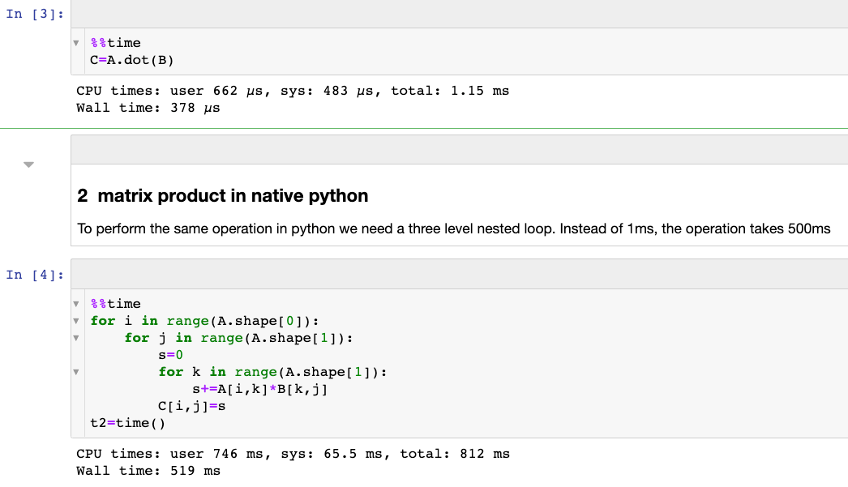
Numpy vs pure python
From: 4_NumpyVsPurePython.ipynb, A,B are 100X100

Slide 5

Big data starts when your data cannot fit in the memory of one computer.

Slide 6
Throughput vs latency
Throughput: the number of bytes processed per second
Can benefit from parallelism
Can benefit from processing blocks of data.
Important for data science
Latency: The time it takes to process a single byte from input to output.
Does not benefit from parallelism
Does not benefit from processing blocks of data.
Important for gaming, robotics, self-driving cars.

Slide 7
Queues: an example of Latency vs. throughput
Latency: time between joining the line and leaving the store.
Throughput: Number of people coming out of the store per minute.
Minimal latency: Cashier work
The customer cares about latency.
The store cares about throughput (dollars per minute) and to some degree latency (customer happier).

Slide 8
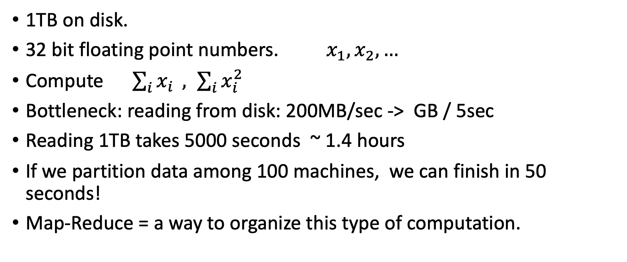
Latency and throughput for big data
1TB on disk.
32 bit floating point numbers. $x_{1},x_{2},…$
Compute $\sum_{i}{x_{i}} , \sum_{i}{x_{i}^{2}}$
Bottleneck: reading from disk: 200MB/sec -> GB / 5sec
Reading 1TB takes 5000 seconds ~ 1.4 hours
If we partition data among 100 machines, we can finish in 50 seconds!
Map-Reduce = a way to organize this type of computation.

Slide 9
Summary / Increasing throughput for Big Data
The bottleneck is usually moving of data, not computation.
Hardware: better to have many cheap/slow/unreliable computers than a few expensive/fast/reliable computing.
Map-Reduce / Hadoop / Spark = Methods for organizing computation on large, unreliable computer clusters.

